Slide 1
Fourier Transforms in Image Processing
Role and Importance of Frequency Domain in Filtering

Slide 2
Introduction
Images can be represented in two domains:
- Spatial domain: pixel intensity values (row & column)
- Frequency domain: how quickly pixel values change (edges, textures)
Fourier Transform (FT) is the tool that converts an image from spatial domain to frequency domain.

Slide 3
Role of Fourier Transform
Breaks down an image into sinusoidal components of different frequencies.
Low frequencies → smooth variations (background, illumination).
High frequencies → rapid changes (edges, fine details, noise).
Helps analyze and process images based on frequency content rather than pixel intensity.

Slide 4
Role of Fourier Transform
A Fourier transform (FT) rewrites an image as a sum of sinusoids of different frequencies and phases.
In the frequency domain you see how quickly pixel values change across the image: slow changes = low frequency, rapid changes (edges, texture, noise) = high frequency.
This separation makes many filtering operations conceptually and computationally simpler.

Slide 5
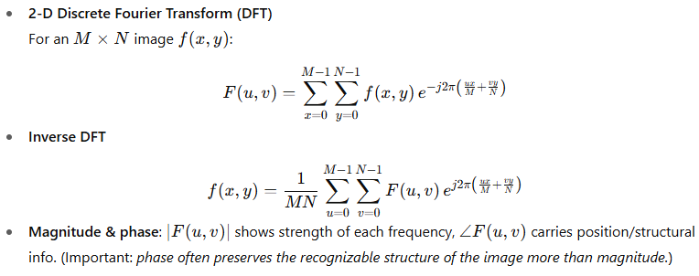

Mathematical Core

Slide 6
Why Frequency Domain Representation?
Some operations are easier in frequency domain than spatial domain.
According to the Convolution Theorem:
Convolution in spatial domain ↔ Multiplication in frequency domain.
Filtering (blurring, sharpening, noise removal) becomes simple multiplication.

Slide 7
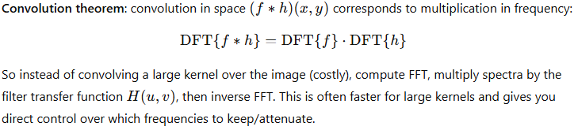
Convolution Theorem

Slide 8
Filtering Operations
Low-pass filtering (LPF):
Keeps low frequencies, removes high frequencies.
Result: image smoothing or blurring.
High-pass filtering (HPF):
Keeps high frequencies, removes low frequencies.
Result: edge enhancement, sharpening.
Band-pass filtering:
Keeps only selected frequency ranges.
Useful for texture analysis.

Slide 9
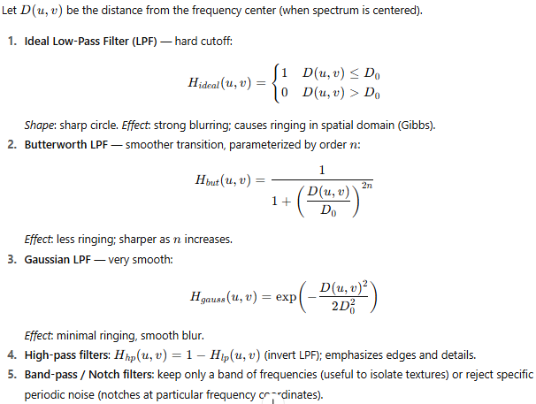

Slide 10
Practical Applications
To remove noise: since noise is often high frequency, apply a low-pass filter.
To sharpen edges: emphasize high frequencies using a high-pass filter.
Medical imaging, satellite images, and fingerprint recognition all rely on Fourier-based filtering.

Slide 11
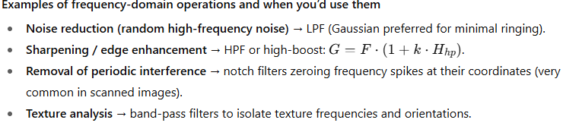
Practical Applications

Slide 12
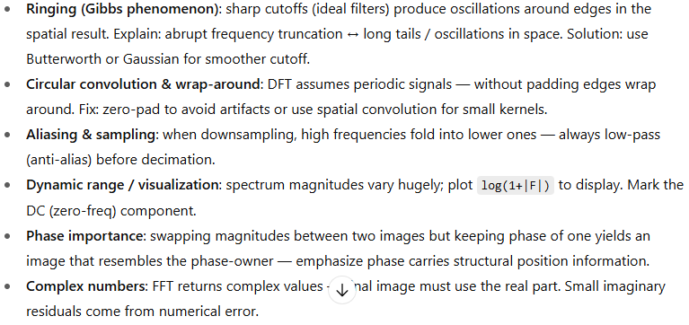

Slide 13
Summary
• Fourier Transform converts image into frequency domain
• Separates low and high frequency components
• Convolution theorem makes filtering simpler
• LPF → smoothing, HPF → sharpening, Band-pass → texture analysis
• Widely used in real-world image processing applications

